Slide 1

Overview
Automotive Diagnostic Introduction
What is Automotive Diagnostics?
General principles
  Request – response method
  Timing
  Service ID overview
  Addressing mode in Diagnostic
On-Board & Off-Board Diagnostics
Security concept - diagnosis sessions
Some real examples
Internal | EMB3 | 9/25/2013 | © Robert Bosch Engineering and Business Solutions Vietnam Company Limited 2013. All rights reserved, also regarding any disposal, exploitation, reproduction, editing, distribution, as well as in the event of applications for industrial property rights.
Notes:
Allgemeines – General
Adressierungsarten – addressing mode

Slide 2

What is Automotive Diagnostics?
Automotive Diagnostic Introduction
Automotive Diagnostics - The entire field of investigation and testing to determine the presence or absence of problems in an automobile, and if there are problems, to determine their causes and possible solutions.
Normally, the information is exchanged between an on-board ECU and a off-board diagnostic tester.
Internal | ESB | 9/25/2013 | © Robert Bosch Engineering and Business Solutions Vietnam Company Limited 2013. All rights reserved, also regarding any disposal, exploitation, reproduction, editing, distribution, as well as in the event of applications for industrial property rights.

Slide 3
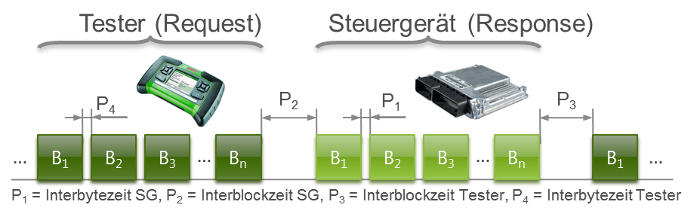
General principles
Automotive Diagnostic Introduction
Diagnostic communication according to the request / response method
Internal | EMB3 | 9/25/2013 | © Robert Bosch Engineering and Business Solutions Vietnam Company Limited 2013. All rights reserved, also regarding any disposal, exploitation, reproduction, editing, distribution, as well as in the event of applications for industrial property rights.

Slide 4
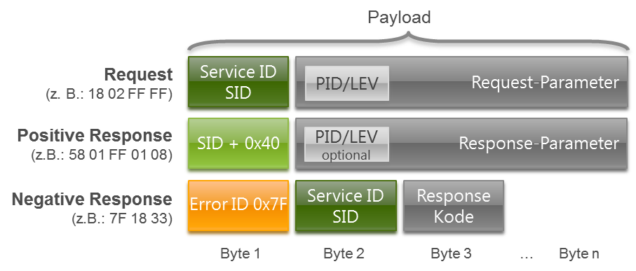
General principles
Automotive Diagnostic Introduction
General communication protocol
Internal | EMB3 | 9/25/2013 | © Robert Bosch Engineering and Business Solutions Vietnam Company Limited 2013. All rights reserved, also regarding any disposal, exploitation, reproduction, editing, distribution, as well as in the event of applications for industrial property rights.

Slide 5
General principles
Automotive Diagnostic Introduction
Timing in Request - Response
Parameter | Name | Value
Inter-byte time for ECU response | P1 | 0 ms | 20 ms
Time between end of Tester request and start of ECU response | P2 | 25 ms | 50 ms
Time between end ECU response and start of next Tester request or between ECU responses during Multiple response mode | P3 | 25 ms | 5 s
Inter-byte time for Tester request | P4 | 1 ms | 20 ms
Internal | EMB3 | 9/25/2013 | © Robert Bosch Engineering and Business Solutions Vietnam Company Limited 2013. All rights reserved, also regarding any disposal, exploitation, reproduction, editing, distribution, as well as in the event of applications for industrial property rights.

Slide 6
General principles
Automotive Diagnostic Introduction
Request | Positive Response | Description
0x00 .. 0x0F | 0x40 .. 0x4F | OBD in ISO 15031-5 Emissions-related diagnostic services
0x10 .. 0x3E 0x83 .. 0x87 | 0x50 .. 0x7E 0xC3 .. 0xC7 | UDS in ISO 14229 KWP2000 in General vehicle diagnostics
0x81.. 0x82 | 0xC1 .. 0xC2 | KWP2000 over K-line in ISO 14230
0xA0 .. 0xB9 | 0xE0 .. 0xF9 | Reverse for OEM
0xBA .. 0xBE | 0xFA ..0xFE | Reverse for ECU manufacturers
Others |  | Reverse
 | Negative Response | Description
 | 0x7F | Error message
Internal | EMB3 | 9/25/2013 | © Robert Bosch Engineering and Business Solutions Vietnam Company Limited 2013. All rights reserved, also regarding any disposal, exploitation, reproduction, editing, distribution, as well as in the event of applications for industrial property rights.

Slide 7
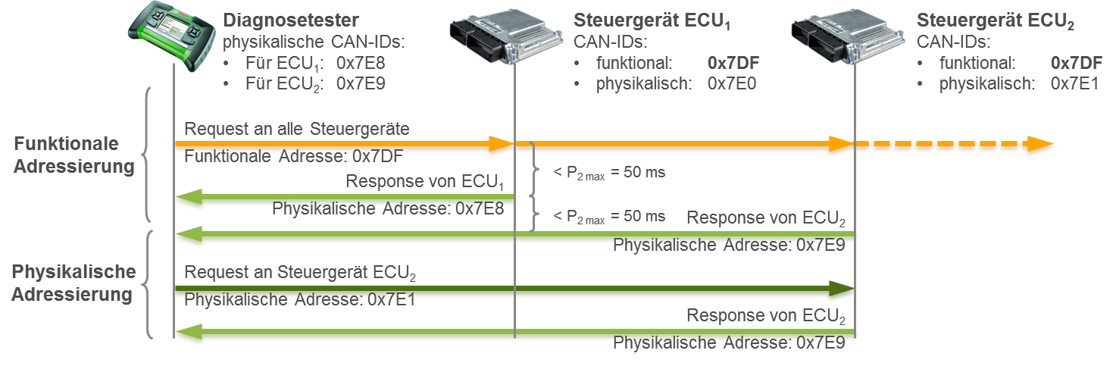
Addressing mode in Diagnostic
Automotive Diagnostic Introduction
Physical address: diagnostic tester and single control device use an unique pair of address
Functional address: diagnostic tester does not know exactly which and how many controllers are installed in the vehicle
Internal | EMB3 | 9/25/2013 | © Robert Bosch Engineering and Business Solutions Vietnam Company Limited 2013. All rights reserved, also regarding any disposal, exploitation, reproduction, editing, distribution, as well as in the event of applications for industrial property rights.
Notes:
- In the simplest case, the so-called physical addressing is used: Here are the diagnostic tester and the single control device a unique pair of addresses. In the case of CAN, the addresses of CAN IDs are shown: with a CAN ID send the tester's messages (requests) to the corresponding control unit, with another sends the controller's response (response) back to the diagnostic tester.
The so-called functional addressing one has used for cases in which the diagnostic tester does not know exactly which and how many controllers are installed in the vehicle.
Functional addressing mode only applicable for tester request ECU, In the reverse direction - from the control devices to the tester - is always used the physical address.

Slide 8
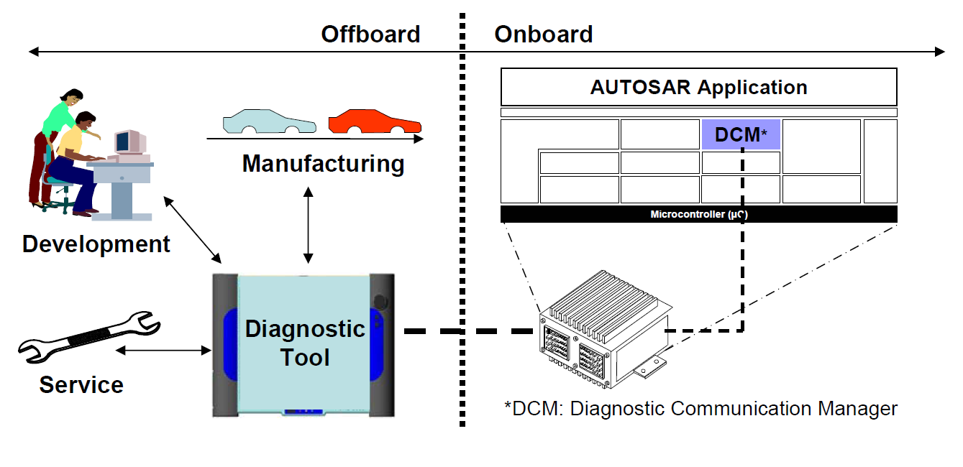
On-Board & Off-Board Diagnostics
Automotive Diagnostic Introduction
Diagnosis protocol
KWP2000, UDS | OBD
Internal | EMB3 | 9/25/2013 | © Robert Bosch Engineering and Business Solutions Vietnam Company Limited 2013. All rights reserved, also regarding any disposal, exploitation, reproduction, editing, distribution, as well as in the event of applications for industrial property rights.

Slide 9
On-Board Diagnostics
Automotive Diagnostic Introduction
OBD systems give the vehicle owner or a repair technician access to state of health information for various vehicle sub-systems.
Early instances of OBD would simply illuminate a malfunction indicator light, or MIL, if a problem was detected - but would not provide any information as to the nature of the problem.
Modern OBD implementations use a standardized series of diagnostic trouble codes, or DTCs, which allow one to rapidly identify and remedy malfunctions within the vehicle.
Internal | EMB3 | 9/25/2013 | © Robert Bosch Engineering and Business Solutions Vietnam Company Limited 2013. All rights reserved, also regarding any disposal, exploitation, reproduction, editing, distribution, as well as in the event of applications for industrial property rights.
Notes:
- Is a generic term referring to a vehicle's self-diagnostic and reporting capability.
- Virtually all modern vehicles include an ECU. When the ECU detects a problem it cannot fix, it trips the MIL and stores a trouble code for later retrieval that points the mechanic toward possible systems or mechanisms involved.

Slide 10
OBD – AUTOSAR with DCM
Automotive Diagnostic Introduction
Application
Software
Component
Application
Software
Component
nn
Actuator
Software
Component
Sensor
Software
Component
AUTOSAR
Software
AUTOSAR
Interface
AUTOSAR
Interface
AUTOSAR
Interface
..............
AUTOSAR
Interface
AUTOSAR Runtime Environment (RTE)
Communication
Services
AUTOSAR COM
DCM
Diagnostic Com.
Manager
<Bus specific>
State Manager
Generic NM Interface
<Bus specific>
NM
IPDU Multiplexer
PDU Router
<Bus specific> Transport Protocol
Communication Hardware Abstraction
Communication Drivers
Internal | EMB3 | 9/25/2013 | © Robert Bosch Engineering and Business Solutions Vietnam Company Limited 2013. All rights reserved, also regarding any disposal, exploitation, reproduction, editing, distribution, as well as in the event of applications for industrial property rights.
Notes:
Role of DCM
Ensures diagnostic data flow and manages the diagnostic states (diagnostic sessions and security states)
Supports UDS (ISO 14229-1) and OBD (ISO 15031-5) with protocol layer and service layer
Is independent from the network (CAN, FlexRay,..)
Usage of DCM
All services run on the protocol layer
In the service layer, DCM provides standard diagnostic service implementations
DCM is part of the CUBAS ComStack and configured by
1. The CUBEC configuration tool that generates required configuration .c/.h files
2. Configuration files which have to be adapted manually, *appl*.c/h

Slide 11
Off-Board Diagnostic
Automotive Diagnostic Introduction
With a transport protocol established, you need a diagnostic protocol for defining which messages correspond to particular functions.
Diagnostic Protocols
    KWP2000 (ISO 14230-3)
    UDS on CAN (ISO 15765-3)
ECU 1
ECU 2
KWP 2000 (ISO 14230-3) / UDS (ISO 15765-3)
KWP 2000 (ISO 14230-3) / UDS (ISO 15765-3)
ISO 15765-2 / Volkswagen TP 2.0
ISO 15765-2 / Volkswagen TP 2.0
CAN / FlexRay
CAN / FlexRay
Internal | EMB3 | 9/25/2013 | © Robert Bosch Engineering and Business Solutions Vietnam Company Limited 2013. All rights reserved, also regarding any disposal, exploitation, reproduction, editing, distribution, as well as in the event of applications for industrial property rights.

Slide 12
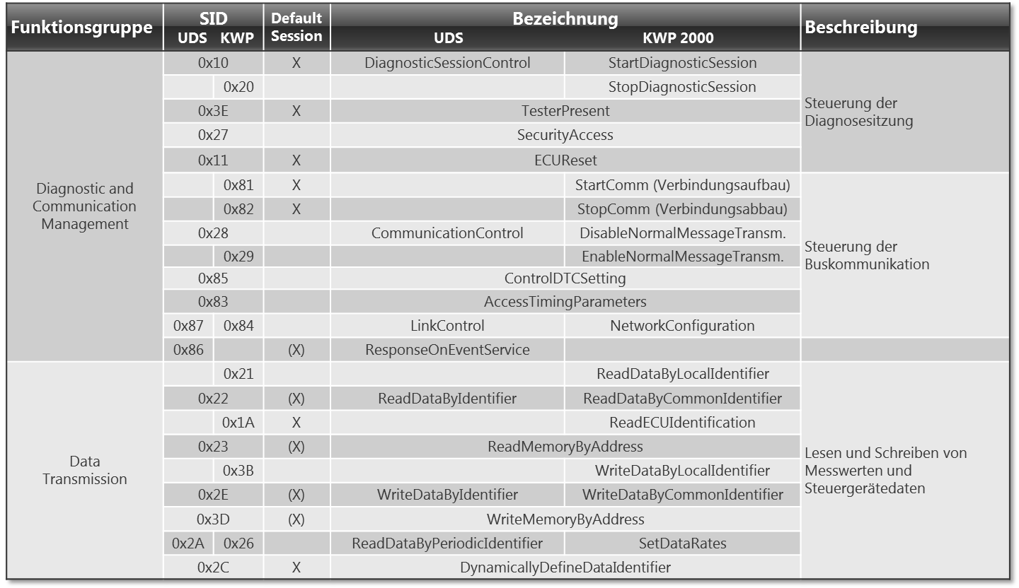
Off-Board Diagnostic
Automotive Diagnostic Introduction
Internal | EMB3 | 9/25/2013 | © Robert Bosch Engineering and Business Solutions Vietnam Company Limited 2013. All rights reserved, also regarding any disposal, exploitation, reproduction, editing, distribution, as well as in the event of applications for industrial property rights.

Slide 13
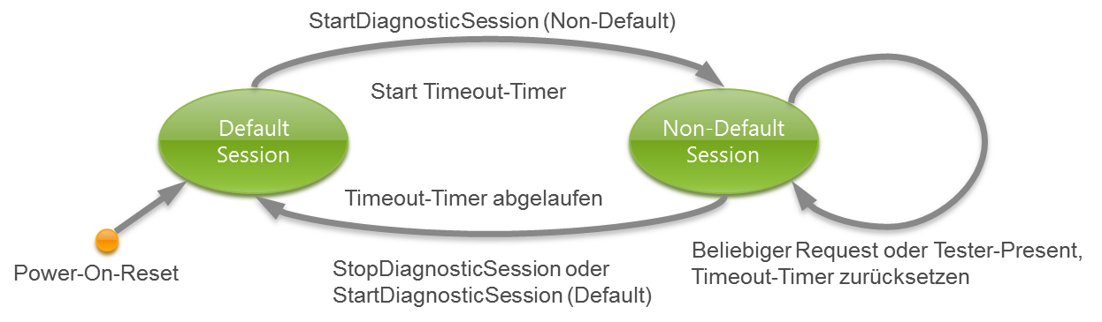
Security concept - diagnosis sessions
Automotive Diagnostic Introduction
No security concept for OBD
At UDS and KWP 2000, however, there are a whole series of services involving ECU content could be manipulated. Therefore, it is there a security policy that prevents unlimited access to the ECU.
Internal | EMB3 | 9/25/2013 | © Robert Bosch Engineering and Business Solutions Vietnam Company Limited 2013. All rights reserved, also regarding any disposal, exploitation, reproduction, editing, distribution, as well as in the event of applications for industrial property rights.
Notes:
With OBD, there is no security concept. This is not critical insofar as the OBD diagnostic services can retrieve data from the control unit only. The only diagnostic service, the content here changes the ECU is the service that clears the fault memory.
At UDS and KWP 2000, however, there are a whole series of services involving ECU content could be manipulated. Therefore, it is there a security policy that prevents unlimited access to the ECU.

Slide 14
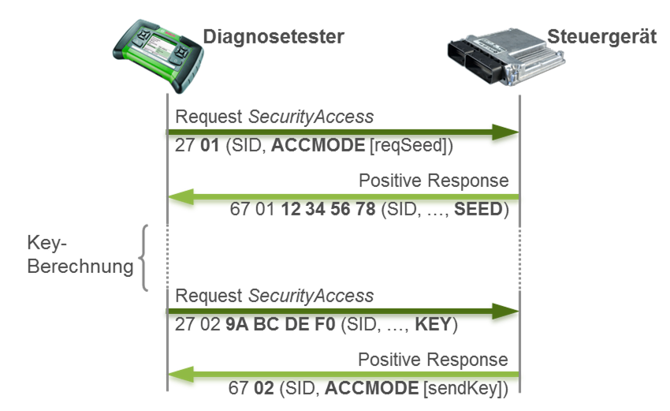
Security concept - diagnosis sessions
Automotive Diagnostic Introduction
Internal | EMB3 | 9/25/2013 | © Robert Bosch Engineering and Business Solutions Vietnam Company Limited 2013. All rights reserved, also regarding any disposal, exploitation, reproduction, editing, distribution, as well as in the event of applications for industrial property rights.

Slide 15
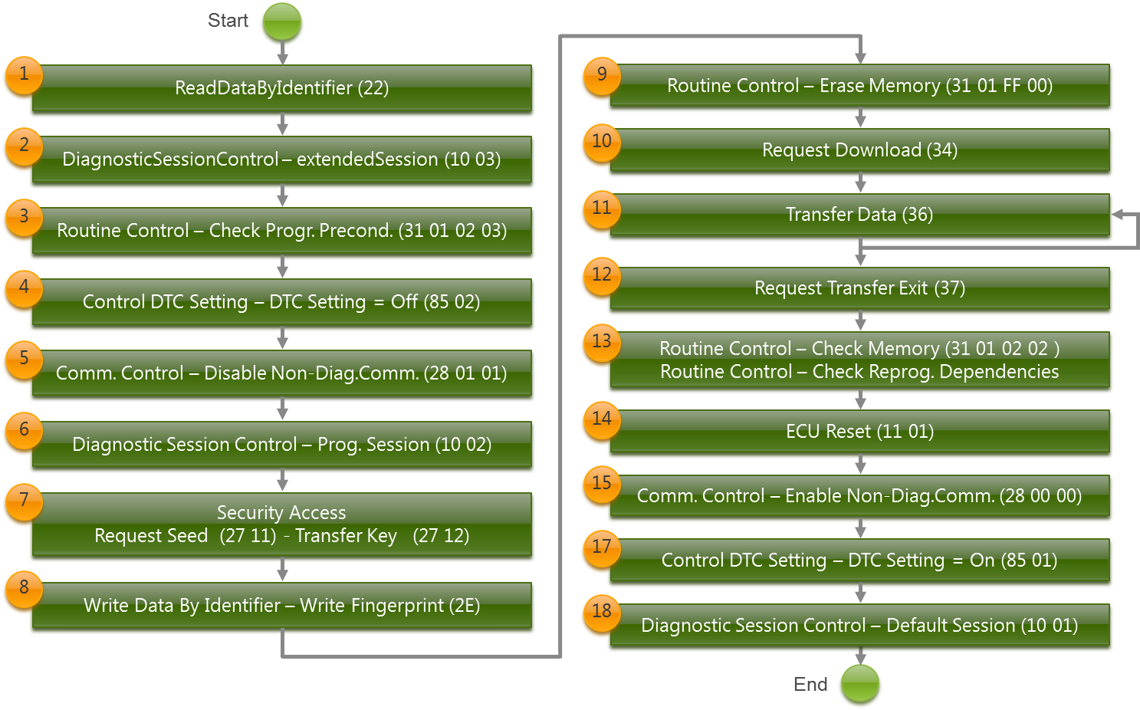
Some real examples – Flash programming
Automotive Diagnostic Introduction
Internal | EMB3 | 9/25/2013 | © Robert Bosch Engineering and Business Solutions Vietnam Company Limited 2013. All rights reserved, also regarding any disposal, exploitation, reproduction, editing, distribution, as well as in the event of applications for industrial property rights.
Notes:
RDBI $22: reads the hardware ID and software ID
DSC $10: PID: $03: switches to a special diagnostic session, Not the actual diagnosis session for the program, but a session in which there are a number of advanced services available

